Slide 1
Budget Preparation Forms and Instructions (Updates)
FY 2027 BUDGET FORUM
Acting Assistant Director Junaid Ibne M. Karim
DBM Budget and Management Bureau - E

Slide 2
Outline of Presentation
BP Forms and Instructions (with Changes)
Major
Minor
Required Supporting Documents to Budget Proposals
Updates in Annex B of the National Budget Call

Slide 3
BP Forms and Instructions
✓

Slide 4


FY 2027 Budget Preparation (BP) Forms and Instructions
Total Number of
BP Forms
-22-
Number of BP Forms with Changes
-6-

Slide 5
BP Form (22) | Title | With Changes
A | Program Budget Matrix
B | Agency Performance Measures
C | Summary of RDC Inputs and Recommendations on Agency Programs and Projects | ✓
D | Report of CSO’s Inputs on Ongoing and New Spending Projects and Activities
100 | Statement of Revenues (General Fund) | ✓
100-A | Statement of Revenues and Expenditures (Earmarked Revenues) | ✓
100-B | Statement of Other Receipts/Expenditures (Off-Budgetary and Custodial Funds)
100-C | Statement of Donations and Grants (In Cash or In Kind)
200 | Comparison of Appropriations and Obligations
201 | Summary of Obligations and Proposed Programs/Projects
201-A | Obligations for Personnel Services (PS)
201-B | Obligations for Maintenance and Other Operating Expenditure (MOOE)
201-C | Obligations for Financial Expenses (FinEx)
201-D | Obligations for Capital Outlays (CO)
201-E | Summary of Outyear Requirements
202 | Profile for Tier 2 Budget Proposals | ✓
203 | Profile for Foreign-Assisted Projects | ✓
204 | Staffing Summary of Non-Permanent Positions | ✓
205 | List of Retirees
206 | Convergence Programs and Projects
207 | Climate Change Expenditures
300 | FY 2027 Proposed Provisions

Slide 6
BP Forms and Instructions (with Changes)
✓

Slide 7
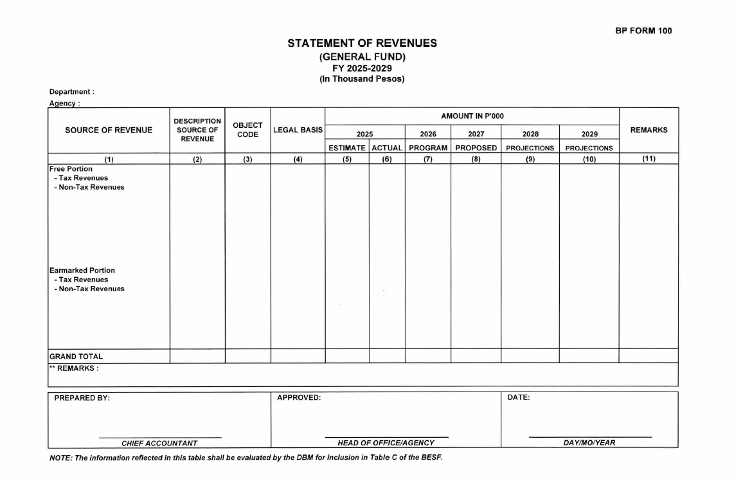
BP FORMS WITH MAJOR CHANGES
BP FORM 100
STATEMENT OF REVENUES (GENERAL FUND)
Modified the Instructions for Column 11:
From: Assumption/basis in the projection of income. Significant increase/decrease in the income projection for FYs 2027-2029 vis-a-vis prior and current year level must be fully justified. Reasons for material deviations of income realization in FY 2025 compared with the FY 2025 income estimate shall also be justified.
To: Assumption/basis in the projection of income. Any significant increase/decrease in the updated income projections for FYs 2026-2029, vis-à-vis the prior year's level and original estimates for the same fiscal years as reflected in the FY 2026 BESF, as applicable, must be fully justified. Reasons for material deviations of income realization in FY 2025 compared with the FY 2025 income estimate shall also be justified.

Slide 8
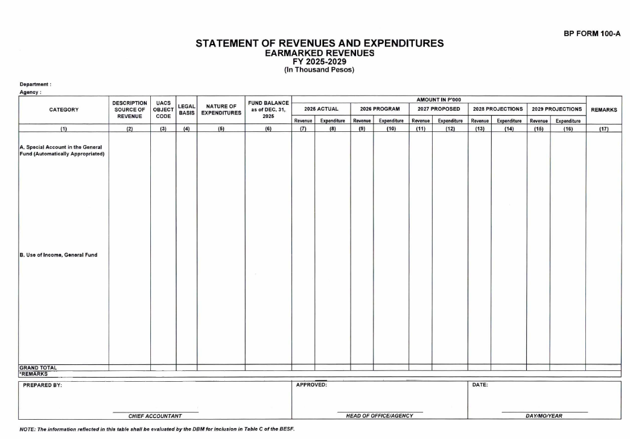
BP FORMS WITH MAJOR CHANGES
BP FORM 100-A
STATEMENT OF REVENUES AND EXPENDITURES
(EARMARKED REVENUES)
Modified the Instructions for Columns 9-10:
From: FY 2026 BESF figures consistent with BP Form 100.
To: Revenues shall be based on FY 2026 BESF figures or the BP Form 100 updated estimates, if any, while expenditures shall be based on the approved level of Special Account, Automatic Appropriations consistent with the FY 2026 NEP.

Slide 9
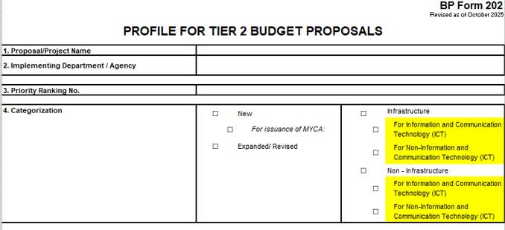
BP FORMS WITH MAJOR CHANGES
BP FORM 202
PROFILE FOR TIER 2 BUDGET PROPOSALS (BOX No. 4)
Additional checkboxes to categorize items as ICT and Non-ICT within the “infrastructure” and “non-infrastructure” category.
Modified the Instructions for Box No. 4:
From: Category of the proposal. First, determine if the proposal is a new project or an expansion of an on-going project. In the case of a new project, indicate if there is a need for MYCA issuance or not. Second, determine whether the project is infrastructure or non-infrastructure.
To: Category of the proposal. First, determine if the proposal is a new project or an expansion of an on-going project. In the case of a new project, indicate if there is a need for MYCA issuance or not. Second, determine whether the project is infrastructure, non-infrastructure, or for Information and Communication Technology (ICT).

Slide 10
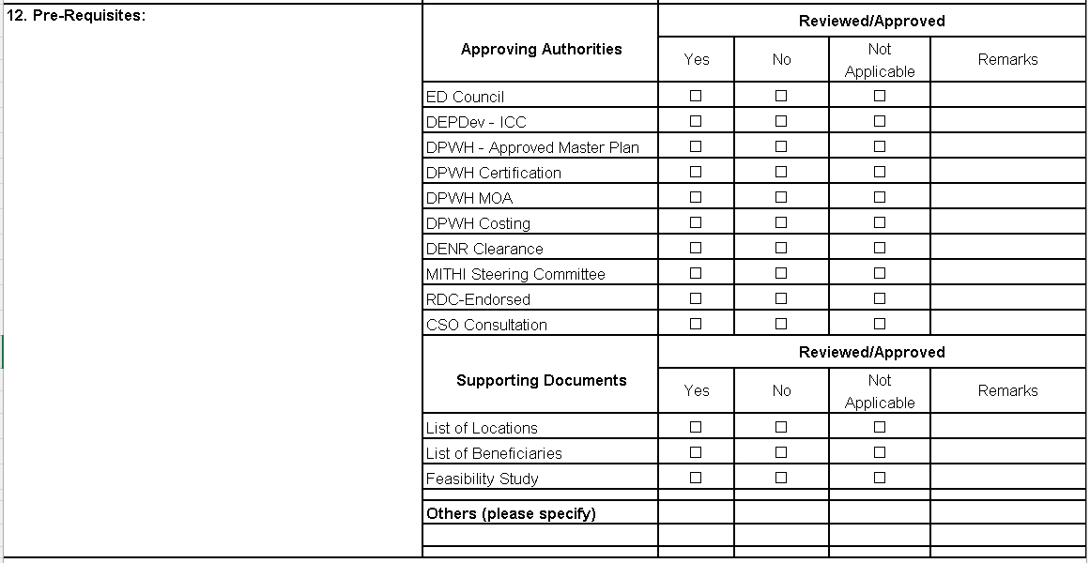
BP FORMS WITH MAJOR CHANGES
BP FORM 202
PROFILE FOR TIER 2 BUDGET PROPOSALS (BOX No. 12)
Additional Approving Authorities pertaining to the following:
DPWH – Approved Master Plan
MITHI Steering Committee

Slide 11
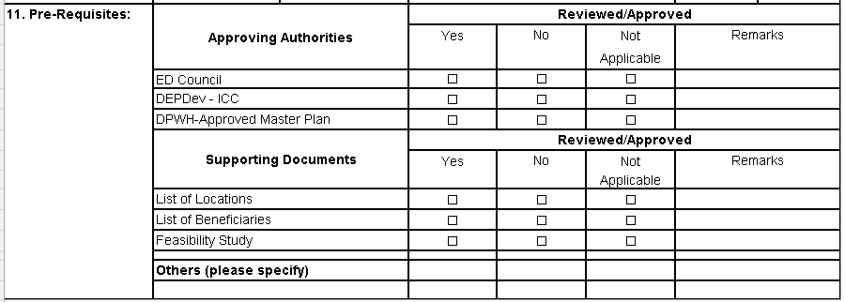
BP FORMS WITH MAJOR CHANGES
BP FORM 203
PROFILE FOR FOREIGN-ASSISTED PROJECTS (BOX No. 11)
Additional Approving Authority pertaining to the DPWH-Approved Master Plan
Inclusion of an extra column labeled as “No”.

Slide 12
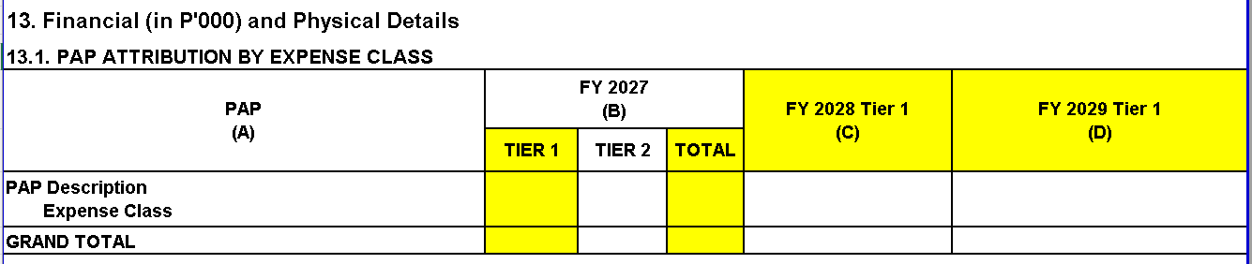
BP FORMS WITH MAJOR CHANGES
BP FORM 202
PROFILE FOR TIER 2 BUDGET PROPOSALS (BOX No. 13.1)
Inclusion of Tier 1 and Total Columns
Instructions for Box No. 13.1 Modified:
For each identified P/A/P, disaggregated by expense class, provide the:
• FY 2027 amounts for Tier 1, Tier 2 and the Total.
• Outyear requirements of the FY 2027 Tier 2 budget proposals into the FYs 2028 and 2029 Tier 1 columns, as applicable
Present each P/A/P in the same level of detail required in BP Forms 201 – Schedules A, B, C and D. (Please refer to BP Form 201: Schedules A, B, C and D)
Note: If in Box No. 4 (i.e., Categorization) the agency marked Expanded/Revised, the FY 2027 Tier 1 column is a required field.

Slide 13
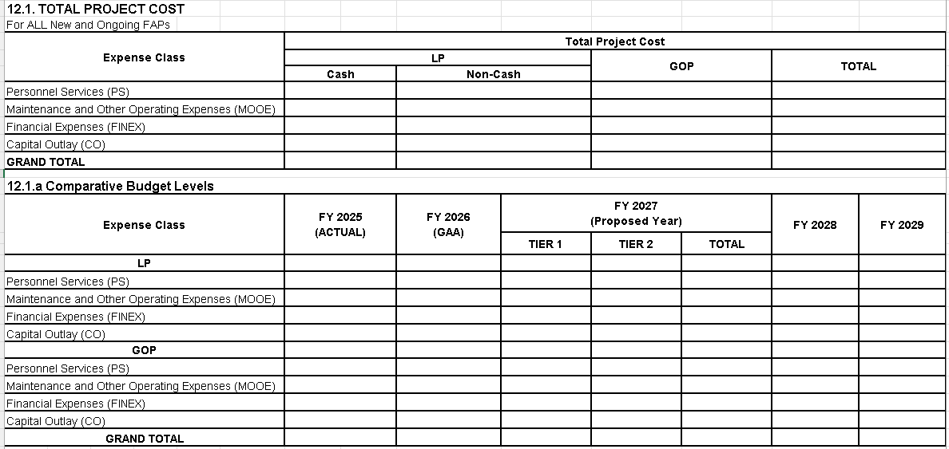
BP FORMS WITH MAJOR CHANGES
BP FORM 203
PROFILE FOR FOREIGN-ASSISTED PROJECTS (BOX No. 12.1/12.1.a)
Inclusion of the Box No. 12.1.a pertaining to Comparative Budget Levels.
Modified the Instructions for Box No. 12.:
From: Total project cost of the project. This shall correspond to the total cost in the corresponding FOA. The total cost shall be disaggregated by expense class, by category (loan proceeds, government counterpart), and by component (cash, non-cash).
To: Total project cost of the project. This shall correspond to the total cost in the corresponding FOA, including Actual Obligations, Current Year Budget, provision under Tier 1, proposal for Tier 2 and out-year requirements. The total cost shall be disaggregated by expense class, by category (i.e., loan proceeds, government counterpart), and by component (i.e., cash, non-cash).

Slide 14
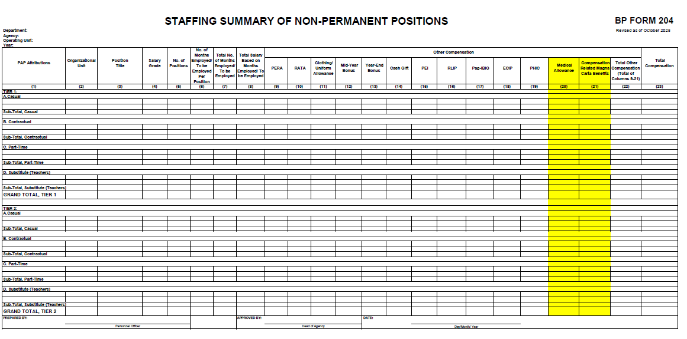
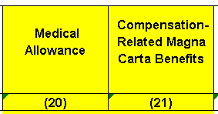
BP FORMS WITH MAJOR CHANGES
BP FORM 204
STAFFING SUMMARY OF NON-PERMANENT POSITIONS
Additional columns pertaining to the following:
Medical Allowance
Compensation-Related Magna Carta Benefits
Additional Instructions:
Column 21: Compensation-Related Magna Carta Benefits - shall be computed based on the applicable guidelines, rules, and regulations for the grant of Compensation-related Magna Carta Benefits of qualified personnel. The amount computed in this Column shall be specific for qualified non-permanent positions only.

Slide 15
BP FORMS WITH MINOR CHANGES
BP Forms / Instructions | Remarks
1.
2.
3.
4.
5.
6.
BP Form C
Renamed the Title.
BP Form 202 (Box No. 5)
Renamed the Box Subject/Title.
BP Form 202 (Box No. 12)
Renamed some of the Approving Authorities and included a row for Supporting Documents.
BP Form 203 (Box No. 5)
Renamed the Box Subject/Title.
BP Form 203 (Box No. 10.1)
Renamed the Column Subject/Title.
BP Form 203 (Box No. 11)
Renamed some of the Approving Authorities and included a row for Supporting Documents.

Slide 16
Required Supporting Documents to Budget Proposals
✓

Slide 17
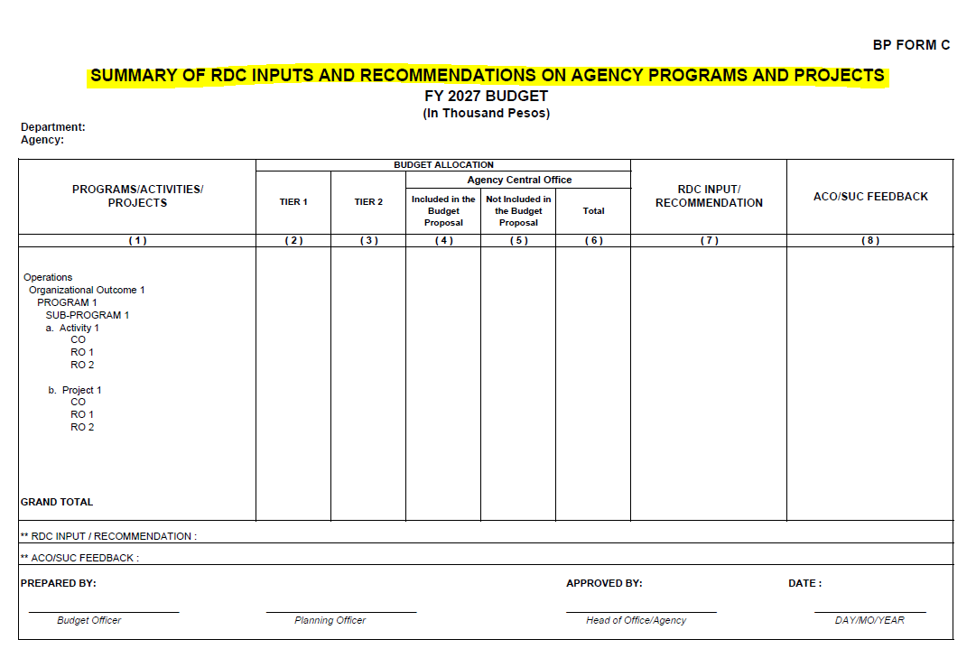

REMINDER: REQUIRED SUPPORTING DOCUMENTS TO BUDGET PROPOSALS
BP FORM C
SUMMARY OF RDC INPUTS AND RECOMMENDATIONS ON AGENCY PROGRAMS AND PROJECTS

Slide 18
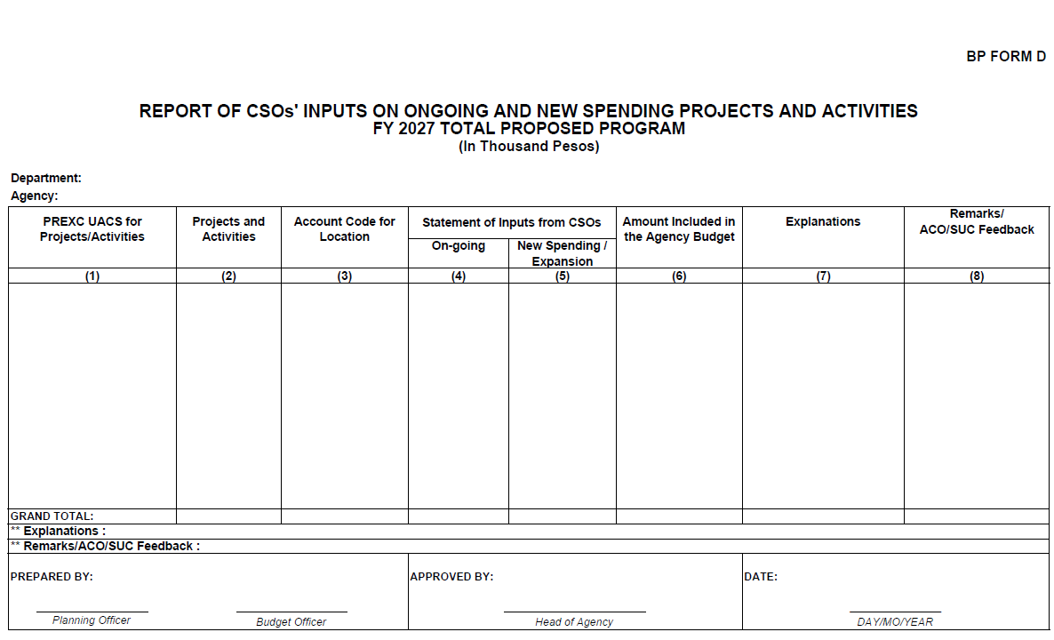

REMINDER: REQUIRED SUPPORTING DOCUMENTS TO BUDGET PROPOSALS
BP FORM D
REPORT OF CSO’s INPUTS ON ONGOING AND NEW SPENDING PROJECTS AND ACTIVITIES

Slide 19
REMINDER: REQUIRED SUPPORTING DOCUMENTS TO BUDGET PROPOSALS
BP FORM 207
CLIMATE CHANGE EXPENDITURES
NOTE: QUALITY ASSURANCE AND REVIEW FORM
The Quality Assurance and Review (QAR) Form approved by the Climate Change Commission (CCC) as prescribed by DBM-CCC JMC 2015-01 will be submitted as Annex to this Form. Hence, departments/agencies shall secure CCC approval of their respective QAR Forms to ensure transparency, consistency, and credibility of the CC Expenditure tagging.

Slide 20
Updates in Annex B
✓

Slide 21
UPDATES IN ANNEX B
SALARIES AND WAGES
Salaries/Wages and Other Compensation of Casual/Contractual Personnel
Inclusion of Medical Allowance:
Provision for non-permanent positions shall be inclusive of other PS-related benefits such as Personnel Economic Relief Allowance (PERA), Uniform/Clothing Allowance, Mid-Year and Year-End Bonus, Cash Gift, Medical Allowance, Productivity Enhancement Incentive (PEI)45, PhilHealth, Pag-IBIG, Employees' Compensation Insurance Premium (ECIP) and Retirement and Life Insurance Premium (RLIP) Contributions, as well as compensation-related Magna Carta Benefits for qualified non-permanent positions.
Footnote: [45] Grant of PEI subject to the results of the RBPMS and PBI System review.

Slide 22
UPDATES IN ANNEX B
OTHER COMPENSATION
Subsistence, Laundry, and Quarters Allowance (SLQA)
Public Social Workers – R.A. No. 9433, dated April 11, 2007, and DBM-Department of Social Welfare and Development (DSWD) JC No, 1, dated December 27, 2018

Slide 23
UPDATES IN ANNEX B
OTHER PERSONNEL BENEFITS
Pension Benefits
Newly Added:
The requirement of agencies with special retirement laws for their officials such as those in the Judiciary, Chairpersons and Members of Constitutional Commissions and other similarly situated officials in the following agencies shall be computed based on the provisions of their respective special retirement laws:
• Office of the Solicitor General (OSG),
• Public Attorney’s Office (PAO),
• Land Registration Authority (LRA),
• National Prosecution Service (NPS) of the
Department of Justice (DOJ),
• Office of the Government Corporate Counsel (OGCC),
• National Labor Relations Commission (NLRC),
Pension of ex-Presidents or their surviving spouses shall also be computed based on the provisions of the applicable special retirement laws.
• Professional Regulation Commission (PRC),
• Energy Regulatory Commission (ERC),
• Office of the Ombudsman,
• Commission on Human Rights, and
• AFP, PNP, BFP, BJMP, PCG, and NAMRIA
• Veterans under Philippine Veterans Affairs Office (PVAO)

Slide 24
UPDATES IN ANNEX B
SUBSISTENCE ALLOWANCE (RATES)
Increase on the Subsistence Allowance of Military and Uniformed Personnel (MUP) in accordance with EO No. 107, dated December 3, 2025.
From: P150.00 per day
To: P350.00 per day

Slide 25
Thank you!

